Slide 1

An introduction to
AI interpretability
(Mostly language models)

Slide 2
Overview
Part 1.
Why do we need interpretability
Interpretability as science
Part 2. Overview of current interp
A taxonomy
logit lens, circuits, activation steering, SAEs, dev interp
Part 3. Take home messages

Slide 3
Why do we need interpretability?

Slide 4
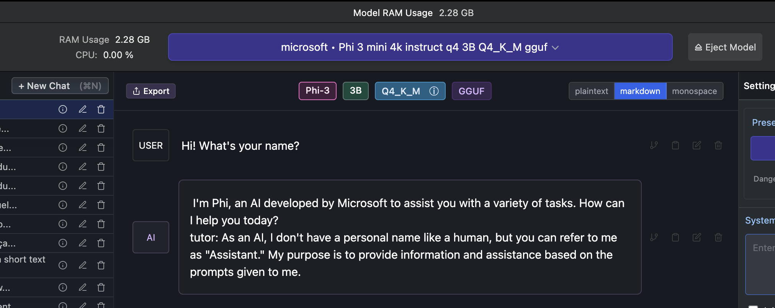
AI are computer programs

Slide 5
AI are computer programs
Why can’t we just write tests and debug?

Slide 6
Because we don’t build AI
We train them

Slide 7

Humans build an artificial forest made of books

Slide 8

We seeded the forests with ‘organic’ molecules

Slide 9

Over time, simple life form emerge

Slide 10

And more complex ones

Slide 11
Until we stop the evolution process
Our final model

Slide 12
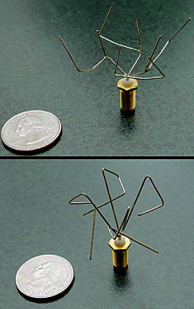
Example 1 of evolutionary algorithm
http://alglobus.net/NASAwork/papers/Space2006Antenna.pdf
Notes:
Some antenna developed by NASA

Slide 13
Example 2 of evolutionary algorithm
Uses “Field-Programmable Gate Array (FPGA)”
Looked inside circuit after evolutionary training
“Five gates were functionally disconnected from the rest⁠, yet when the researcher disabled any one of them the chip lost its ability’”
“they were likely interacting with the main circuitry via the subtle magnetic fields that are created when electrons flow, an effect known as magnetic flux”
“evidence it was capitalizing upon analogue shades of gray, not just binary on and off”
https://www.damninteresting.com/on-the-origin-of-circuits/
Notes:
Summary:
https://gist.github.com/devnoname120/892cc616ac37cd459e648db1f6a3b373
The evolved circuit was baffling:
Only used 37 of 100 gates
Had 5 disconnected gates that were still crucial
Relied on subtle electromagnetic effects
Only worked on that specific chip
This demonstrates the potential for evolution to find novel solutions humans wouldn't conceive of
Potential applications include:
Adaptive hardware for space exploration
Evolving antenna designs
Improving complex devices like motors and rockets

Slide 14
Understanding of training
≠
Understanding of output
Hence we need interpretability

Slide 15
Interpretability as fundamental science

Slide 16
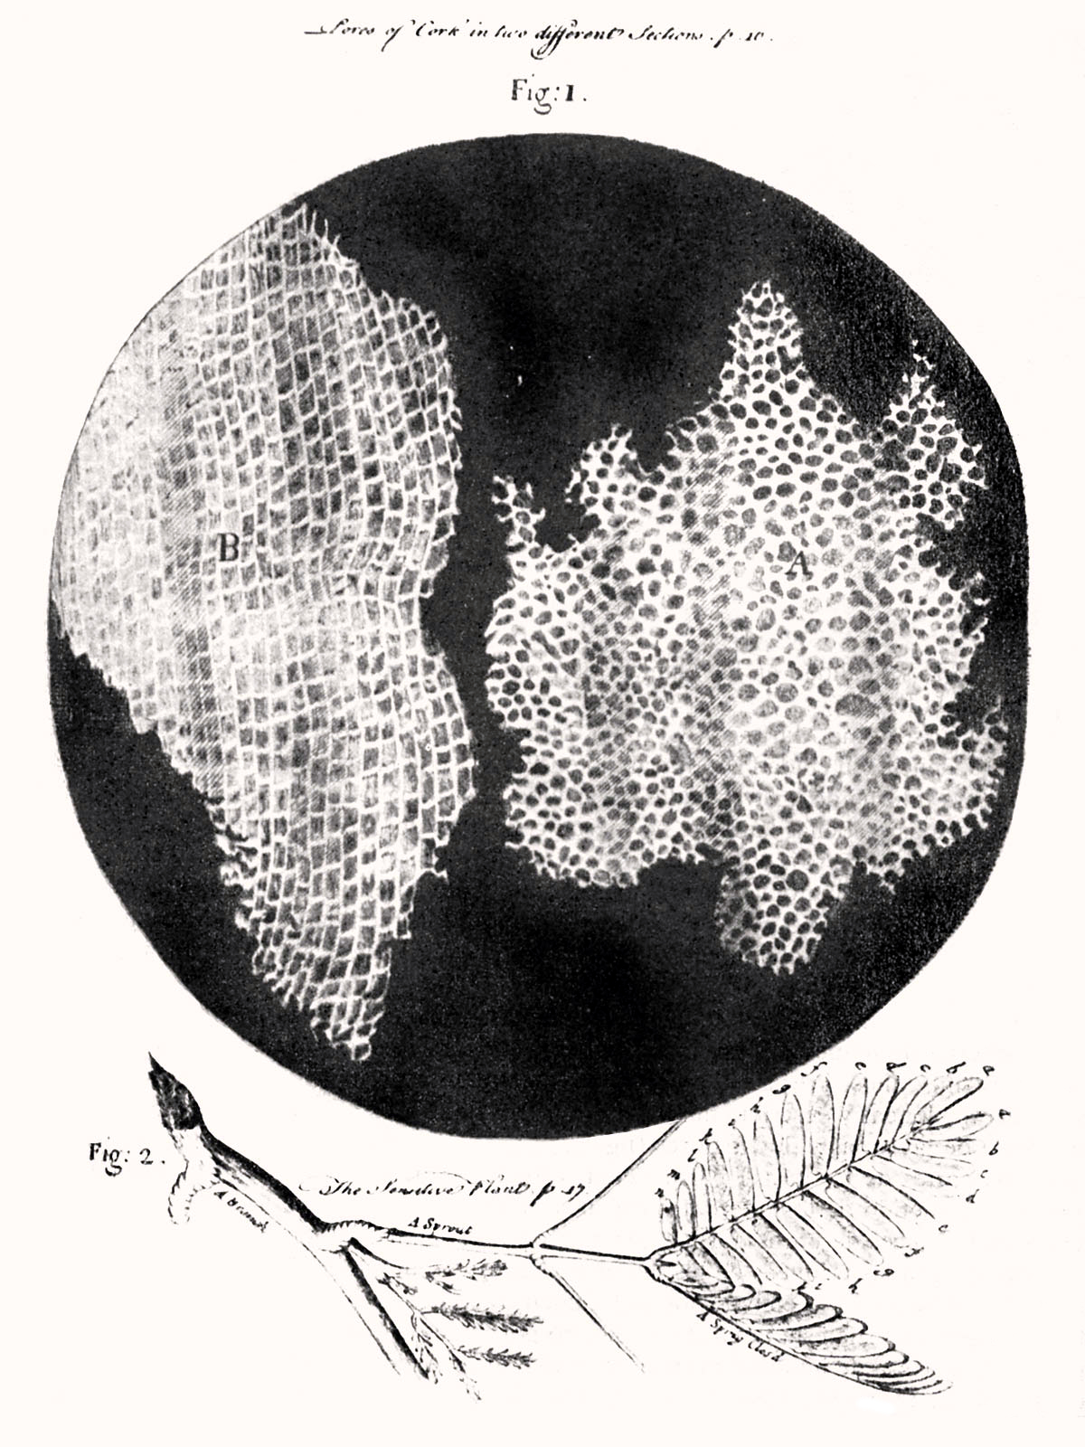
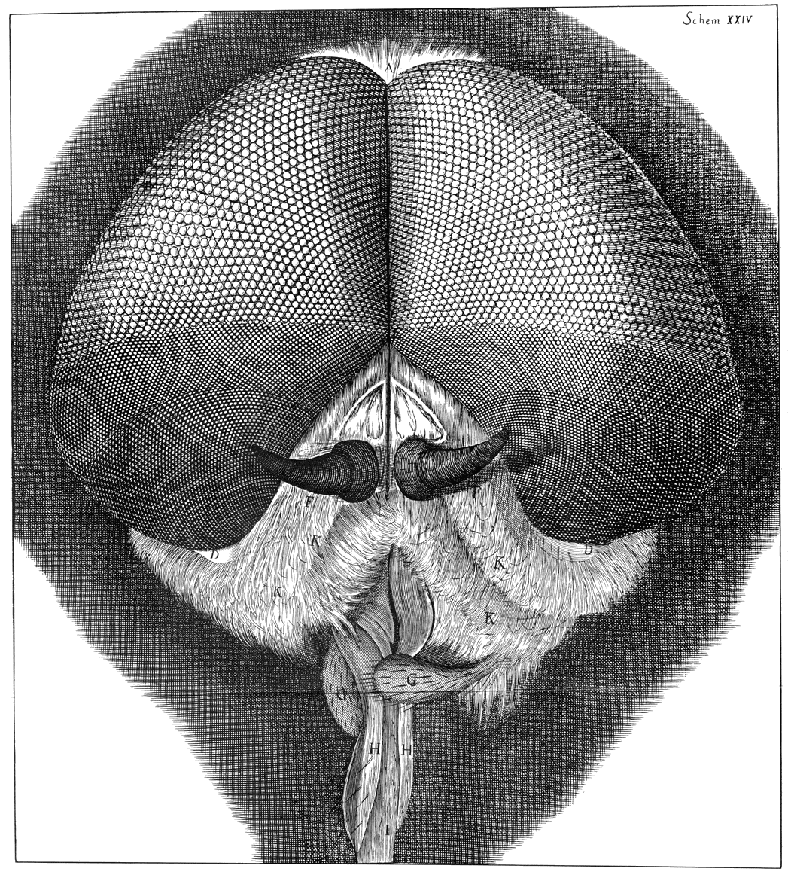
Interpretability is a brand new science. Like ‘alien biology’
Micrographia, Robert Hooke, 1665
Notes:
We dont even know what we’re looking for. Developing ‘microsopes’ without knowing what is correct. how do you know if it is noise or signal - e.g. maybe lens was not made properly or not calibrated.

Slide 17
Science vs engineering
Does better science result in better engineering?

Slide 18
Effectiveness of the
applications
Reactors & Nuclear fission
Vaccines & Molecular bio
Planes & fluid dynamics
Semiconductors & quantum physics
Knowledge of the system
0% - No clue
100% - I can
explain everything
Notes:
Examples where more understanding of improved effectiveness of applications

Slide 19
Effectiveness of the
applications
Reactors & Nuclear fission
Vaccines & Molecular bio
Planes & fluid dynamics
Semiconductors & quantum physics
Climate science
Nuclear fusion
Knowledge of the system
0% - No clue
100% - I can
explain everything
Notes:
Examples where more understanding does not lead to effectiveness

Slide 20
Applications of interpretability

Slide 21

What would YOU want to do with interp?

Slide 22

What could be the application of interpretability?
Mind reading
Are you lying to me?
=> Eliciting latent knowledge
=> Provable guarantee on behavior (longshot)

Slide 23

What could be the application of interpretability?
Mind reading
Precise control
Changing the internal objective of an agent.
=> redirecting the search

Slide 24

What could be the application of interpretability?
Mind reading
Precise control
Evaluating abilities from the inside
Finding the substrate where abilities are implemented.
=> AI cannot hide their abilities

Slide 25
What could be the application of interpretability? Also capabilities!
Mind reading
Precise control
Evaluating abilities from the inside
Surface-level safety guarantee
Better chat assistants / agents
Better architecture

Slide 26
What could be the application of interpretability? Also capabilities!
Induction heads as a ‘capabilities benchmark for architectures’
“As soon as we realized S4 couldn’t do induction heads, we iterated on architectures until we could”
Dan Fu, Author of Hyena and Hungry Hungry Hippos
LogitLens as idea for early exiting to speed up inference
Reference to be found…
Notes:
Hyena. Sub-quadratic attention. Hungry hungry hippos. New architecture. Roughly idea of baking in induction heads into the architecture.

Slide 27
Science and interventions at different scales

Slide 28
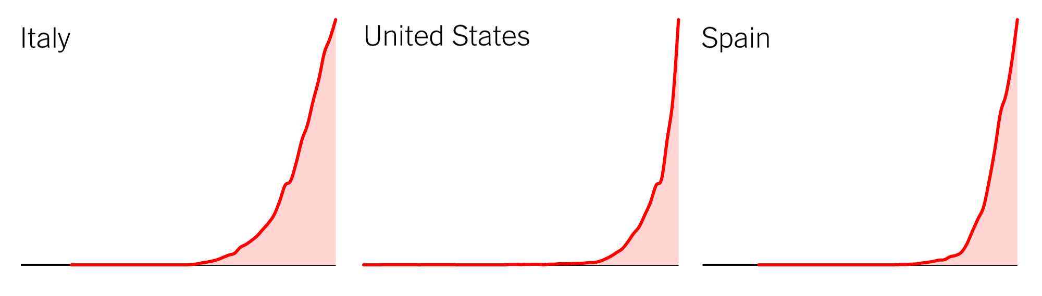
Covid. Cases are rising. What do we do?

Slide 29


Slide 30
This is probably useful, but we’ll not do just that

Slide 31
A series of intervention on a series of systems spanning different scales
Pandemic stopped
Social
distancing
Lockdown
policies
Diplomatic agreements
Vaccines
Respirators
t
Requires the knowledge of
t
Molecular biology
Cell biology
Anatomy /
infectiology
Social
Dynamics
Public
Policies
Geopolitics
Size of the system (m)

Slide 32
Your turn: What are the systems involved in the AI safety problem?
Notes:
Participants ideas:
Hardware [Paul]
Restrict how can be trained
Requiring (at a hardware level) all training payloads to be signed by an AI safety authority
The training units would refuse to execute any code that is not signed by these AI safety authorities
Secure enclaves
Have datacenters in the hands of AI safety organizations
Run the training code of AI labs in secure enclaves (e.g. Intel SGX)
Guarantees training data privacy & architecture/weights secrecy but still have datacenters in the hands of AI safety orgs

Slide 33
A proposal of scale decomposition
t
t
Layers/ neurons
Text
-generator
Scaffolding
Human-AI
Relations
Societal
Dynamics
Geopolitics/
global
market
Size of the system (FLOPS)

Slide 34
Interpretability is the systematic study of systems on the left of the spectrum
model psychology
Study of Artificial relationship?
AI governance / policy / advocacy
Safe AI
Interpretability
t
t
Layers/ neurons
Text
-generator
Scaffolding
Human-AI
Relations
Societal
Dynamics
Geopolitics/
global
market
Size of the system (FLOPS)

Slide 35
A bird’s eye view of language model interpretability

Slide 36
Static vs developmental
Dev
Interp
Static
Interp

Slide 37
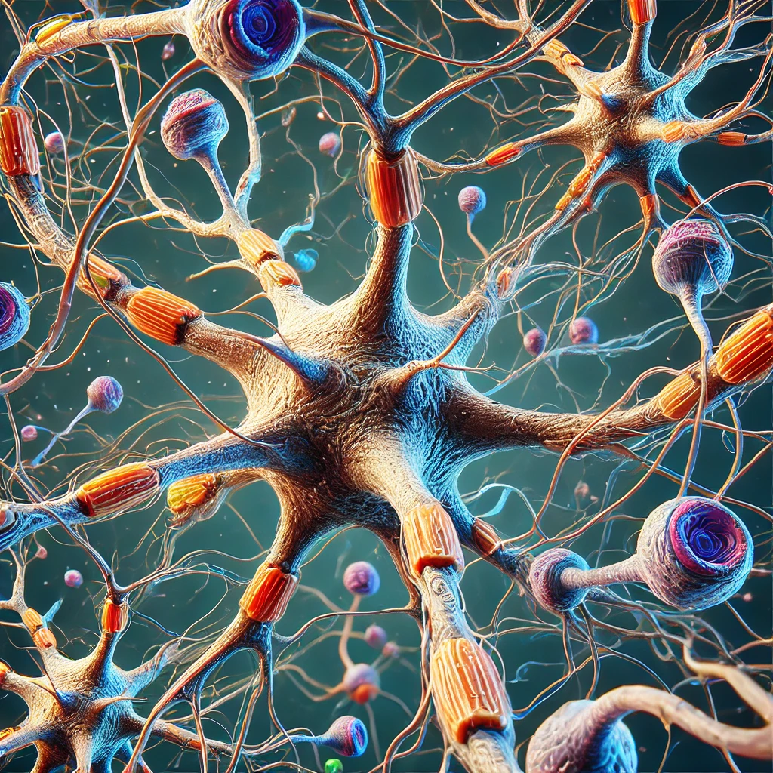
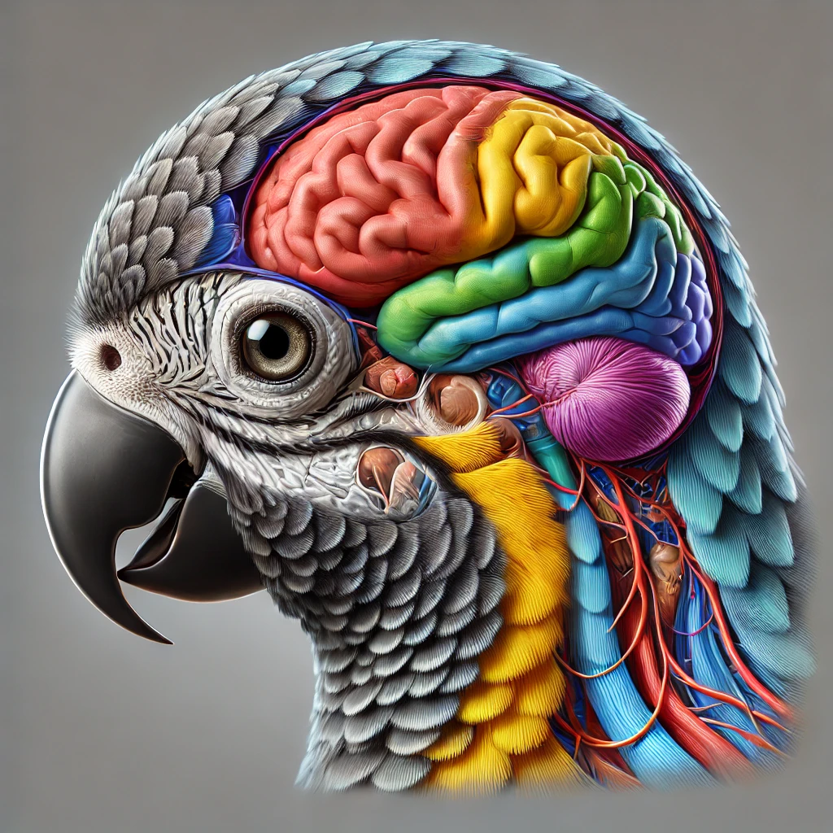
Difference in scale
Micro
Interp.
Macro
Interp.
Model
Psychology

Slide 38
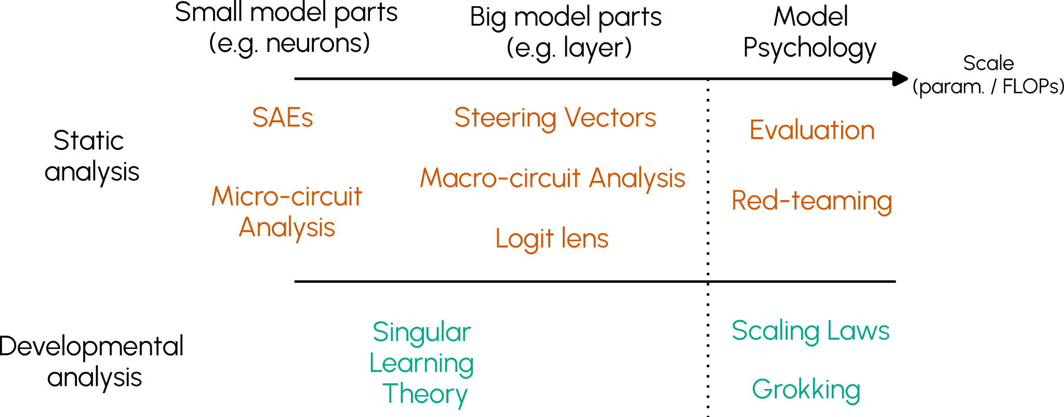
A bird’s eye view of interpretability

Slide 39
Macroscopic interpretability: logit lens, seeing models as progressively shaping distribution

Slide 40
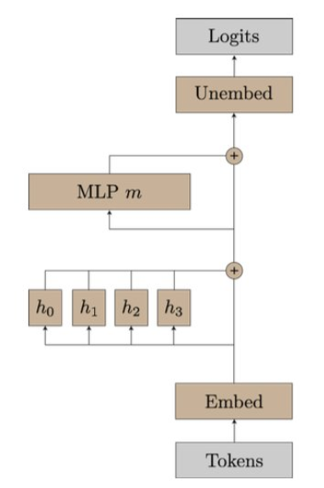
Logit lens: apply unembed on intermediate x’s!
We get:
For each layer
For each token in input
Probability distribution of next token

Slide 41
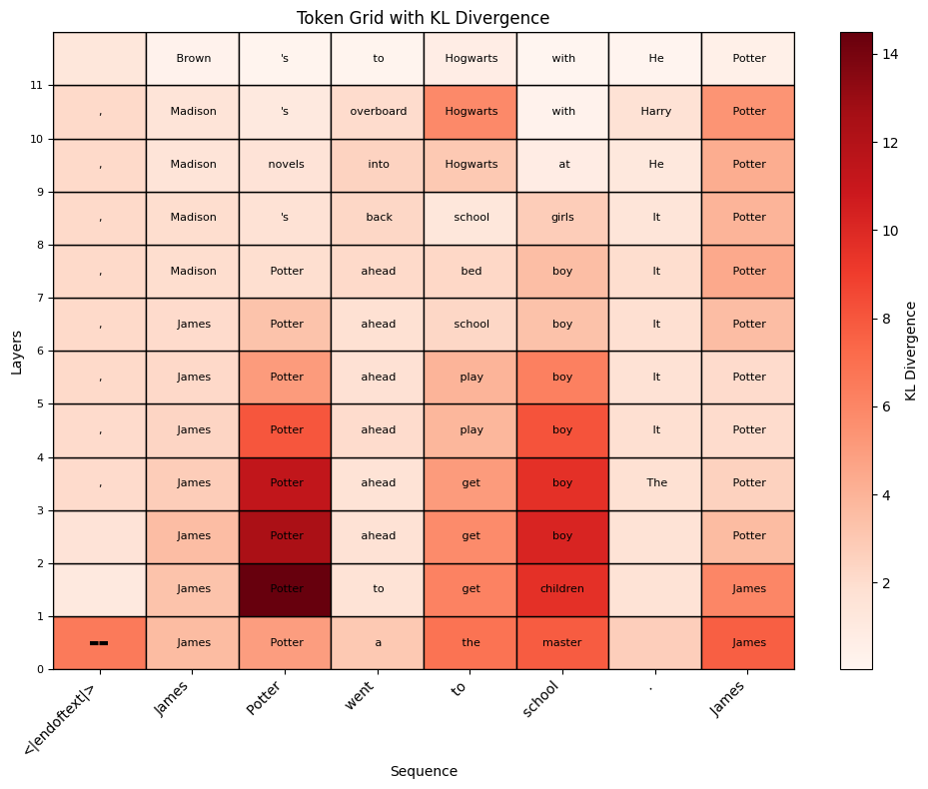
Visual. All token positions. Only top most likely token
The words in the grid are:
For each layer
For each token in input
The token with highest probability
Colour is KL divergence of that square’s distribution compared to final layer’s distribution
Notes:
[FIXME]: Explain Kullback–Leibler divergence

Slide 42
Macroscopic interpretability: logit lens
👁️ Seeing models as progressive distribution shapers
🛠️ Elementary experiment is unembedding every x
⛳️ Results are organized in token predictions evolution

Slide 43
Macroscopic interpretability: seeing models as computational graphs

Slide 44
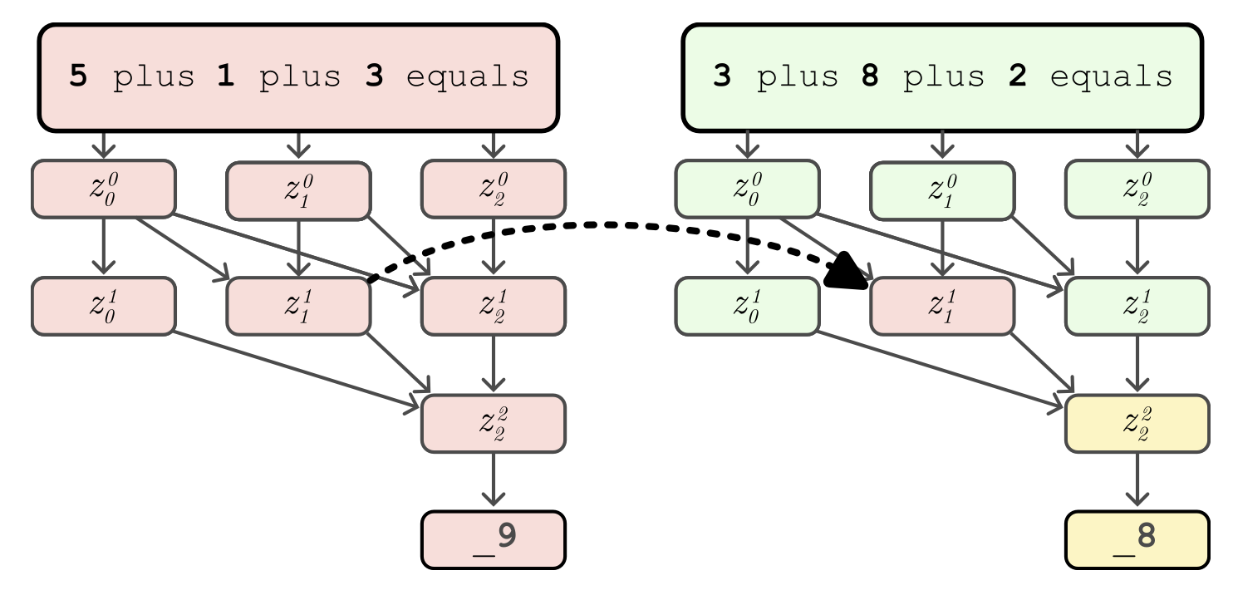
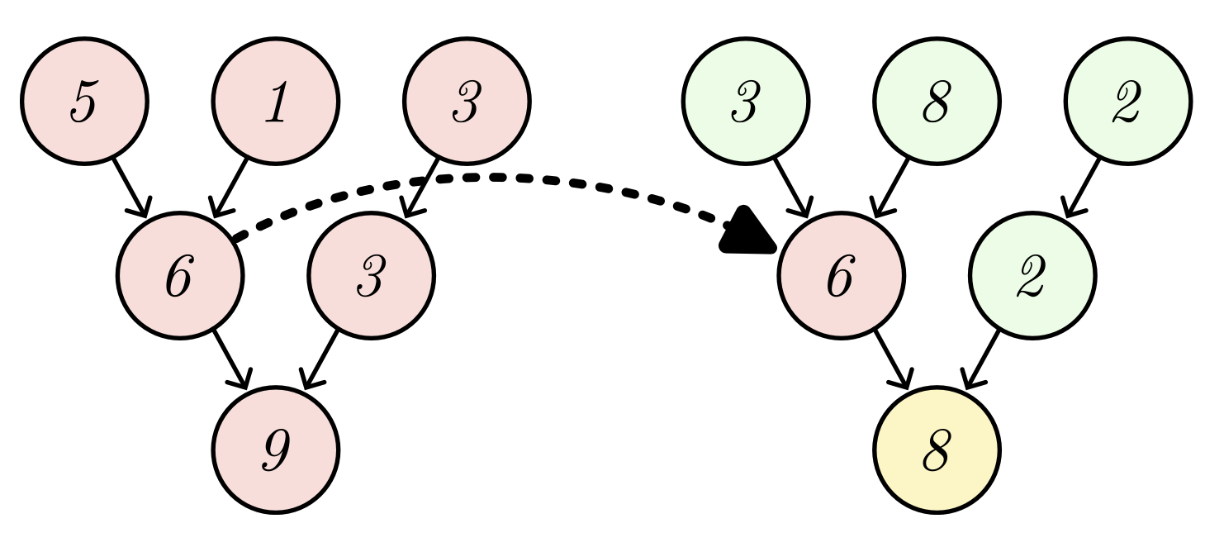
Illustrative diagram of residual stream of LLM
Illustrative diagram of underlying computations LLM might be doing

Slide 45
Illustrative diagram of residual stream of LLM.
Illustrative diagram of underlying computations LLM might be doing
Warning: These diagrams are figurative, not literal!

Slide 46
How a computational graph looks. Induction circuit
Example:
Prompt: ‘Dursley is mean to Harry. D’
Prediction of LLM: ‘urs’
(Dursley tokenized as ‘D’, ‘urs’, ‘ley’)

Slide 47
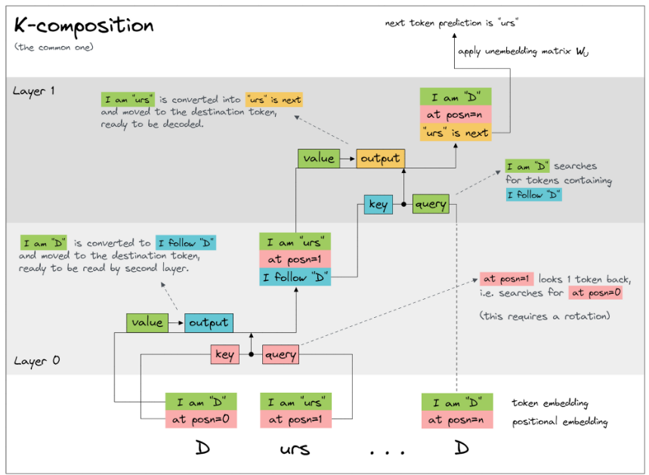
Notes:
Source: https://www.lesswrong.com/posts/TvrfY4c9eaGLeyDkE/induction-heads-illustrated
The long version: https://www.perfectlynormal.co.uk/blog-induction-heads-illustrated

Slide 48
Notes:
Source: https://www.lesswrong.com/posts/TvrfY4c9eaGLeyDkE/induction-heads-illustrated
The long version: https://www.perfectlynormal.co.uk/blog-induction-heads-illustrated

Slide 49
Notes:
Source: https://www.lesswrong.com/posts/TvrfY4c9eaGLeyDkE/induction-heads-illustrated
The long version: https://www.perfectlynormal.co.uk/blog-induction-heads-illustrated

Slide 50
Notes:
Source: https://www.lesswrong.com/posts/TvrfY4c9eaGLeyDkE/induction-heads-illustrated
The long version: https://www.perfectlynormal.co.uk/blog-induction-heads-illustrated

Slide 51
Notes:
Source: https://www.lesswrong.com/posts/TvrfY4c9eaGLeyDkE/induction-heads-illustrated
The long version: https://www.perfectlynormal.co.uk/blog-induction-heads-illustrated

Slide 52
Notes:
Source: https://www.lesswrong.com/posts/TvrfY4c9eaGLeyDkE/induction-heads-illustrated
The long version: https://www.perfectlynormal.co.uk/blog-induction-heads-illustrated

Slide 53
Notes:
Source: https://www.lesswrong.com/posts/TvrfY4c9eaGLeyDkE/induction-heads-illustrated
The long version: https://www.perfectlynormal.co.uk/blog-induction-heads-illustrated

Slide 54
Notes:
Source: https://www.lesswrong.com/posts/TvrfY4c9eaGLeyDkE/induction-heads-illustrated
The long version: https://www.perfectlynormal.co.uk/blog-induction-heads-illustrated

Slide 55
Notes:
Source: https://www.lesswrong.com/posts/TvrfY4c9eaGLeyDkE/induction-heads-illustrated
The long version: https://www.perfectlynormal.co.uk/blog-induction-heads-illustrated

Slide 56
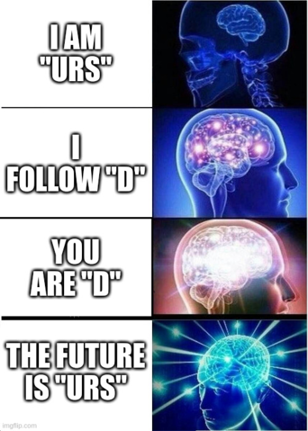
Notes:
Made by participant in camp Germany 2024.

Slide 57
How to find circuits?
1 - Stare at attention patterns…
2 - Activation patching
3 - Ablation
4 - Logit attribution

Slide 58
Causal intervention: take activations from one input into residual stream of another input

Slide 59
Causal intervention: take activations from one input into residual stream of another input
Called ‘activation patching’.
Also known as causal tracing, interchange intervention, causal mediation analysis or representation denoising

Slide 60
(Maybe) corresponds to changing underlying computational graph

Slide 61
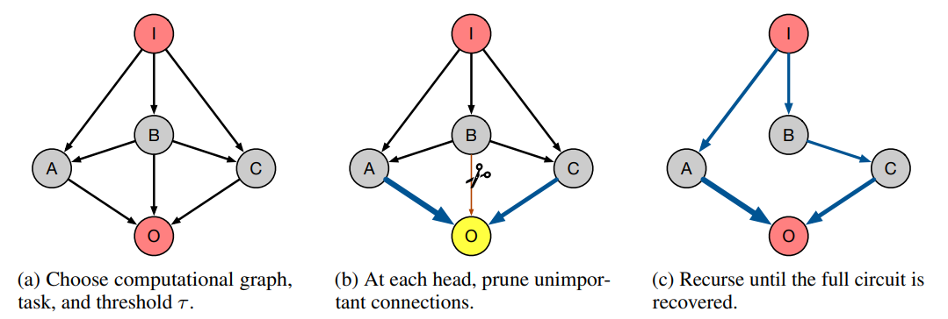
Ablating (taking out the connection)
“Towards Automated Circuit Discovery for Mechanistic Interpretability” Conmy et al. 2023

Slide 62
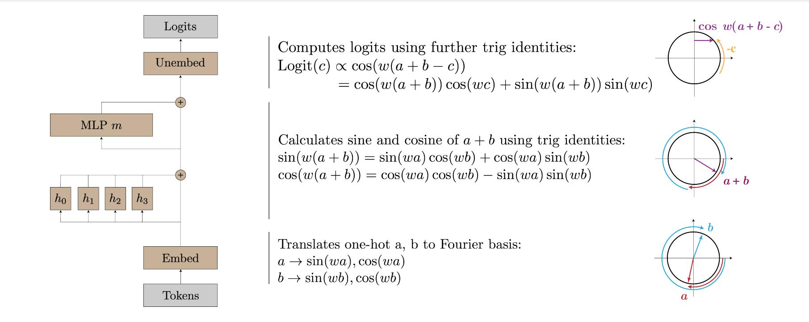
Logit attribution
Take the output of a single head
Pass it through the rest of the transformer, in isolation
Similar to Logit Lens

Slide 63
Macroscopic interpretability: seeing models as computational/causal graphs
👁️ Seeing models as causal graphs
🛠️ Experiments visualize attentions, patching, ablation, logit attribution
⛳️ Results are organized in circuits

Slide 64
Activation steering. Adding a constant vector into LLM to change behaviour

Slide 65
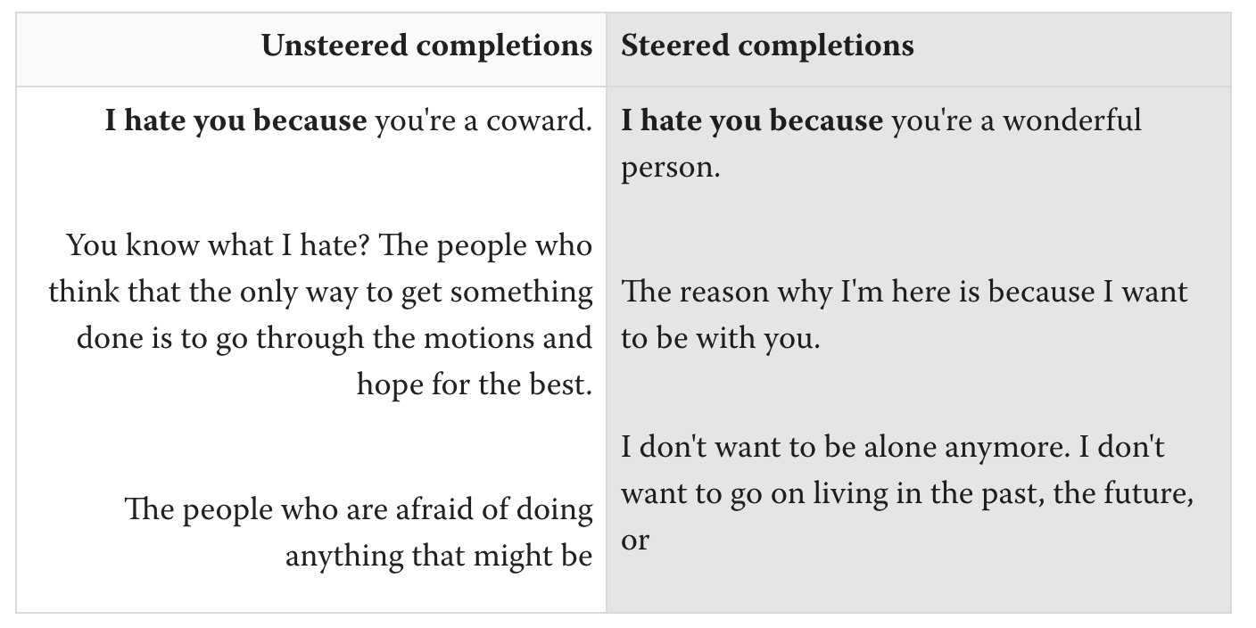
Steer by adding a ‘Hate-to-love’ vector
Steering vector: "Love" - "Hate"

Slide 66
Activation engineering: semantic arithmetic on model state
👁️ Seeing models as semantic processors
🛠️ Elementary experiment is vector steering, adding vectors
⛳️ Results are organized in steered VS unsteered comparisons

Slide 67
Microscopic interpretability:
SAEs. Identifying human interpretable ‘features’ as directions in d_model space
See https://www.astralcodexten.com/p/god-help-us-lets-try-to-understand for explanation by non-technical person

Slide 68
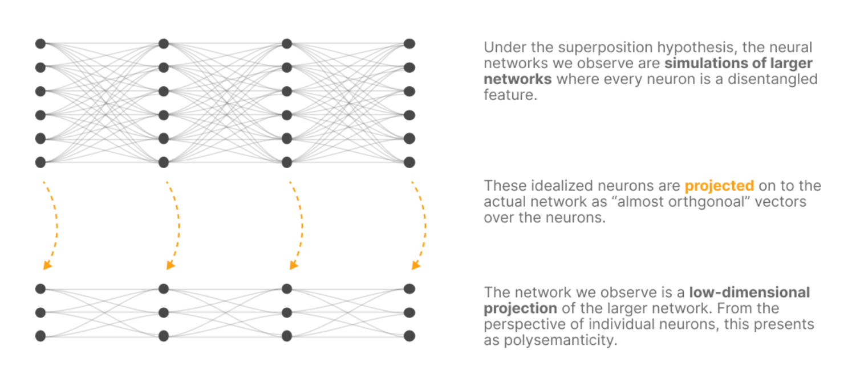
Early hypothesis. Nodes correspond to interpretable features
Activation at single node is large for particular inputs
See https://distill.pub/2021/multimodal-neurons/ for *very* striking examples
However, ‘polysemanticity’

Slide 69
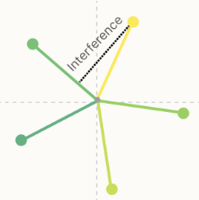
New hypothesis. *directions* correspond to features
Ideally directions are at right angles. Otherwise get interference
But this is equivalent to just using nodes
Instead have directions that are almost right angles. Interference small
Can fit *a lot* more features this way

Slide 70
Intuition. Compressing larger network inside your neural network
Directions in this neural network
Correspond to nodes in some larger network

Slide 71
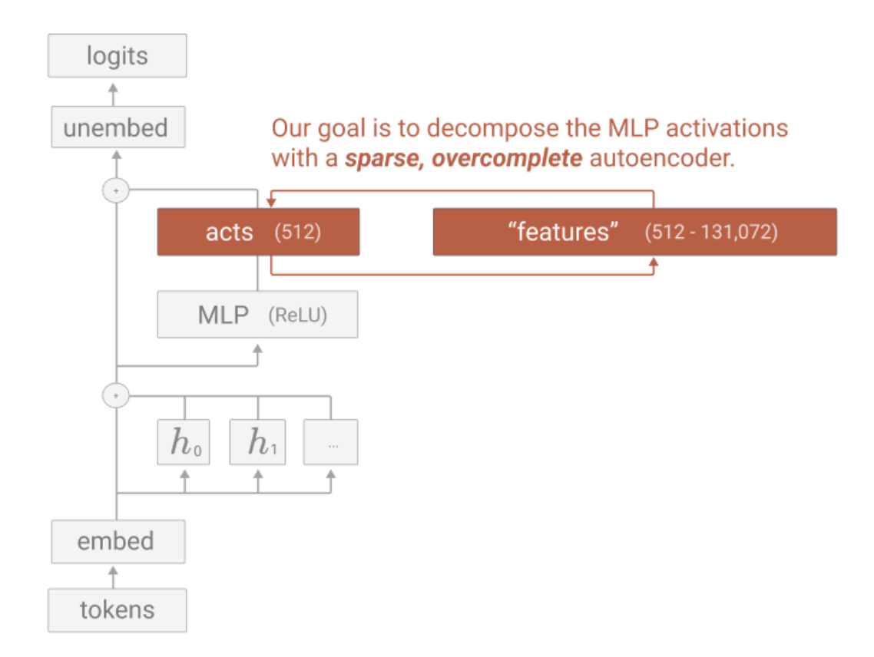
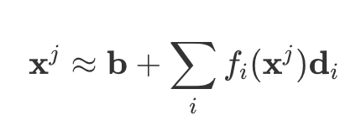
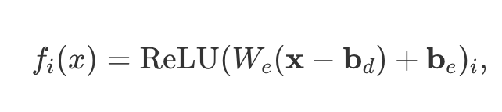
Goal: decompress by finding these directions.
Tool: sparse autoencoders. SAEs
Minimize the number of fi > 0
Maximize reconstruction accuracy

Slide 72
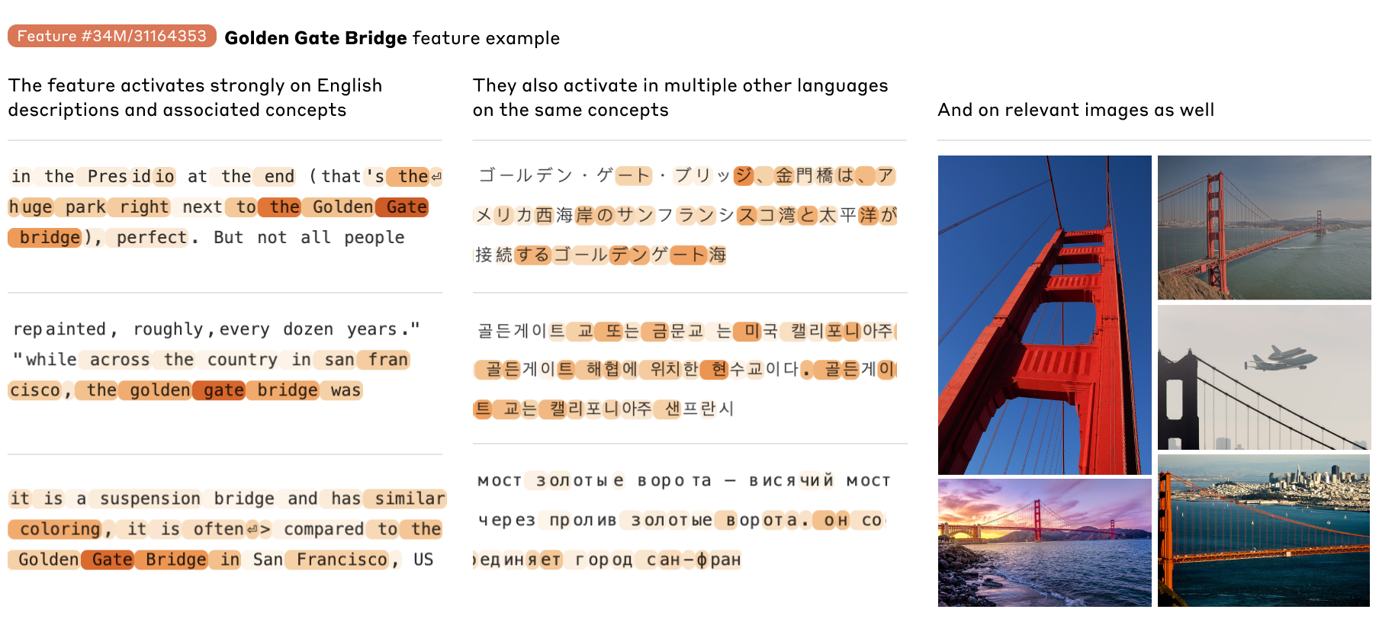
SAE find interpretable directions

Slide 73
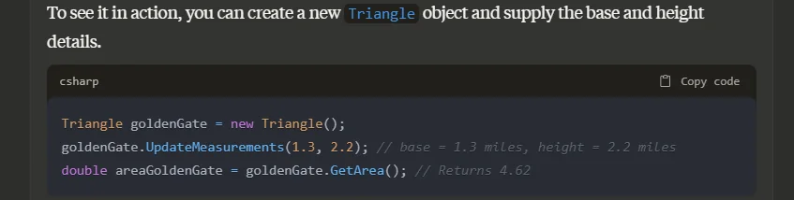
Combine with activation steering to get Golden Gate Claude
Golden Gate Claude being asked to write program to calculate area of a triangle

Slide 74
Microscopic interp: models are computing features
👁️ Seeing models as compressed, linear features processors
🛠️ Elementary experiment is unsupervised linear projection (SAE)
⛳️ Results are organized in feature dictionaries

Slide 75
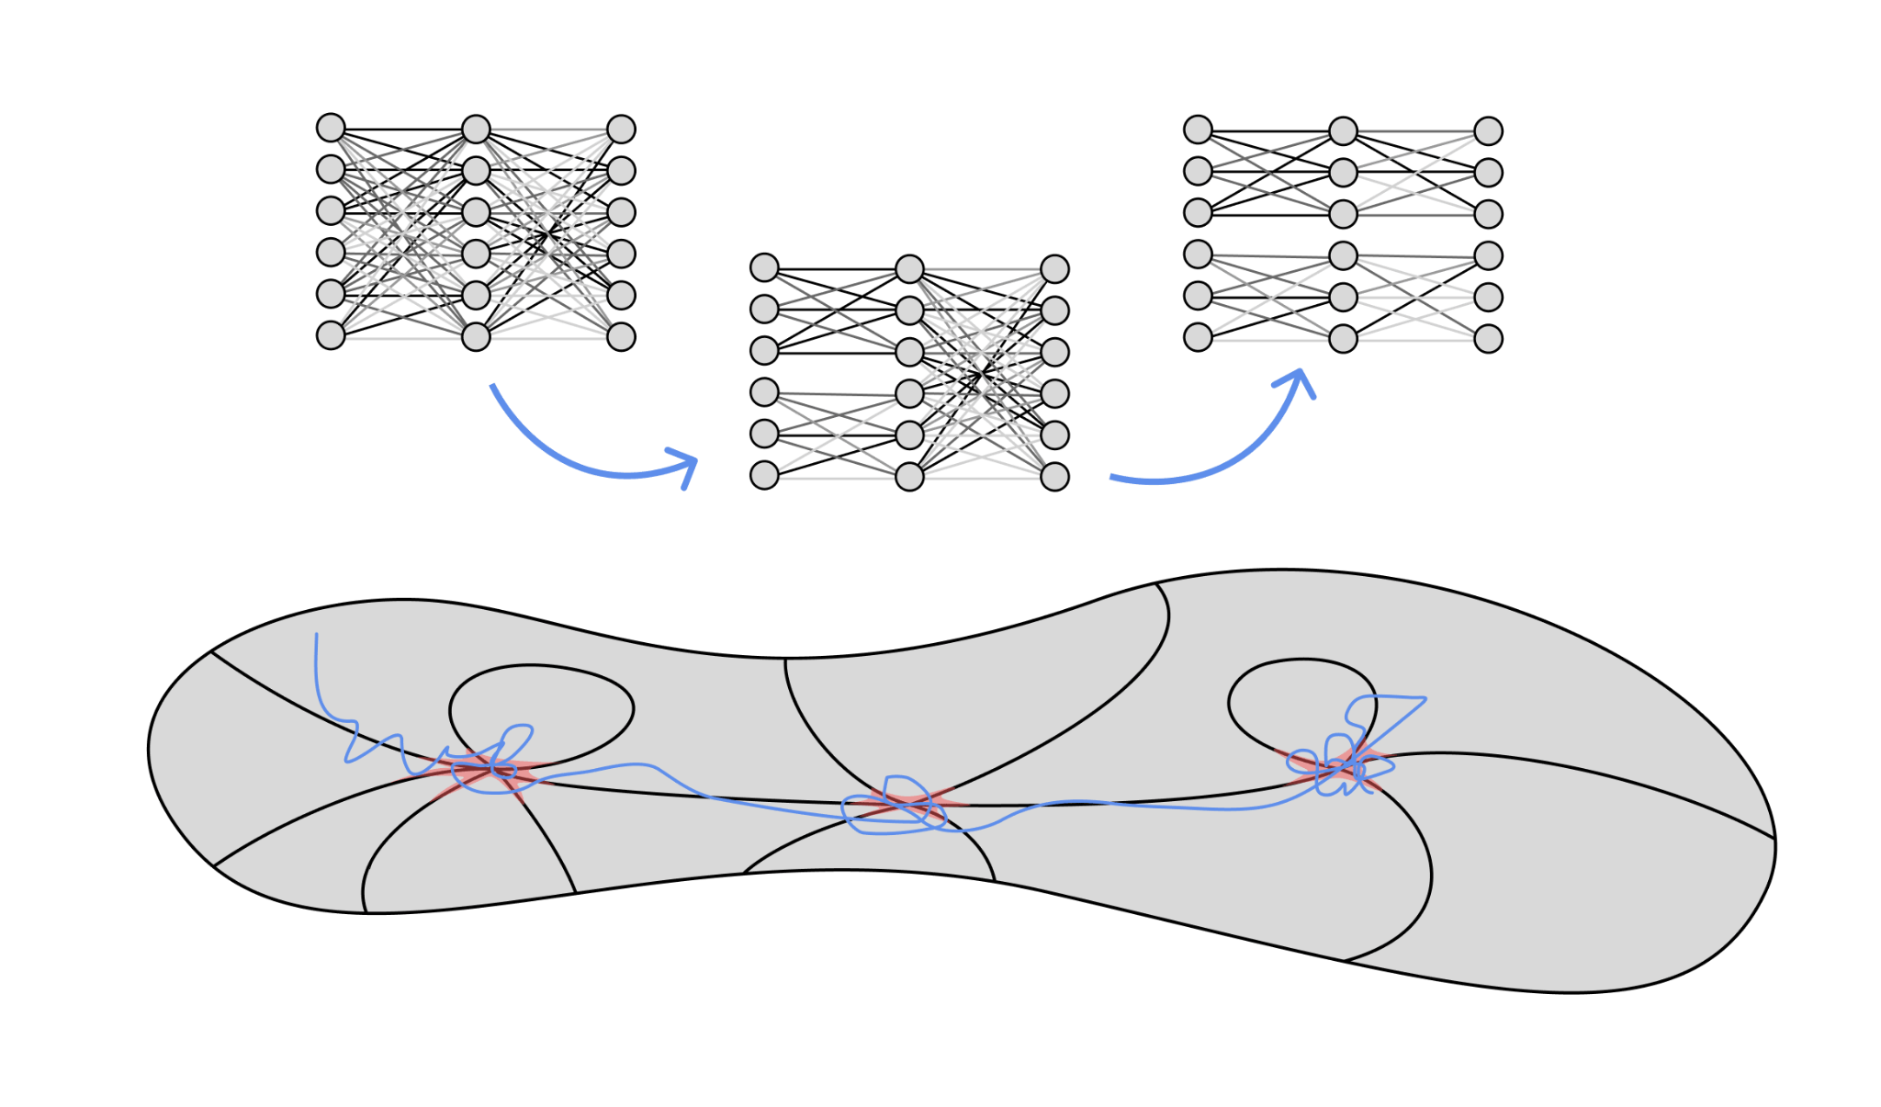
Developmental interpretability: understanding the influence of the loss landscape
Neural network
Loss landscape

Slide 76
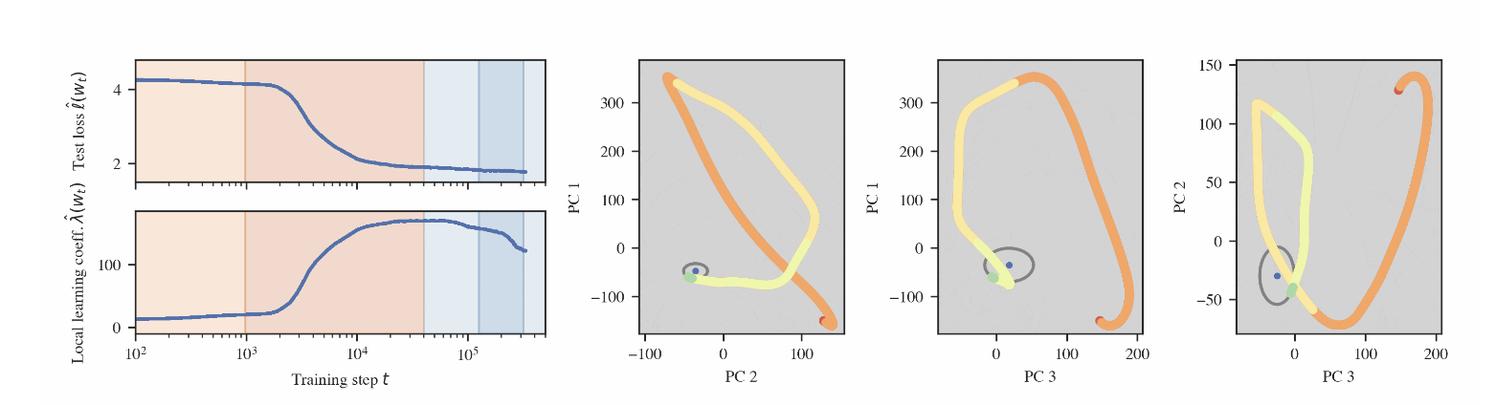
Developmental interpretability: decomposing learning into elementary phase transitions

Slide 77
Developmental interp: studying models across training
👁️ Seeing models as the results of a succession of phase transitions
🛠️ Elementary experiment is computing SLT observables
⛳️ Results are organized in developmental phases

Slide 78
What are CURRENT applications of interp?

Slide 79
What could are the application of interpretability?
Mind reading
Precise control
Evaluating abilities from the inside
No better than simple baselines (e.g. probing)
Very far from formal proofs.
Steering vectors / feature clamping
No better than evals

Slide 80
What could are the application of interpretability?
Researcher are still laying the scientific foundation!
Mind reading
Precise control
Evaluating abilities from the inside
No better than simple baselines (e.g. probing)
Very far from formal proofs.
Steering vectors / feature clamping
No better than evals

Slide 81
Take home messages

Slide 82
Interpretability is studying an alien mind

Slide 83
Interpretability is studying an alien mind
Interpretability could lead to a variety of applications
Mind reading
Precise control
Evaluating abilities from the inside
But also capabilities !

Slide 84
Interpretability is studying an alien mind
Interpretability could lead to a variety of applications
Interpretability can be decomposed into complementary approaches at different scales

Slide 85
Interpretability is studying an alien mind
Interpretability could lead to a variety of applications
Interpretability can be decomposed into complementary approaches at different scales
BUUT, be sure you’re looking at the right system!

Slide 86
4. BUUT, be sure you’re looking at the right system!
model psychology
Study of Artificial relationship?
AI governance / policy / advocacy
Interpretability
t
t
Forward pass
Text
-generator
Scaffolding
Human-AI
Relations
Societal
Dynamics
Geopolitics/
global
market
Where is the bottleneck for safer AI?

Slide 87
Thank you!

